Slide 1


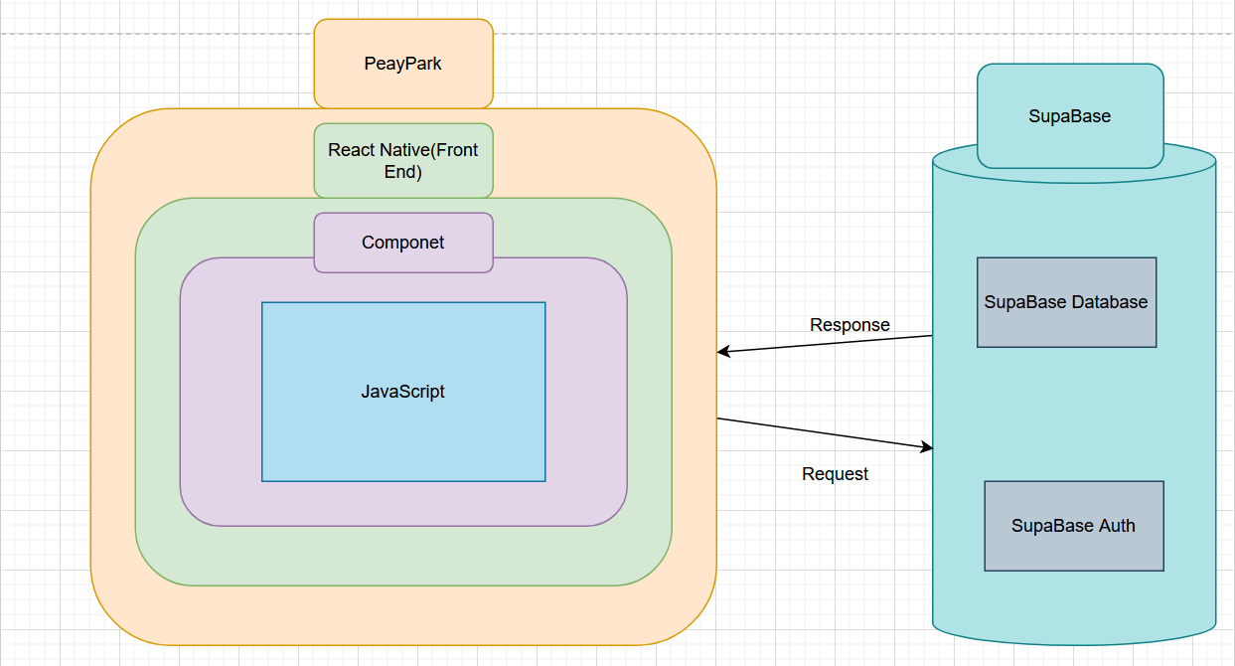

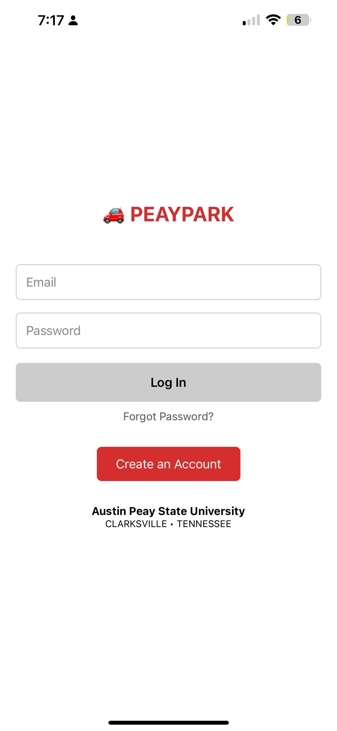
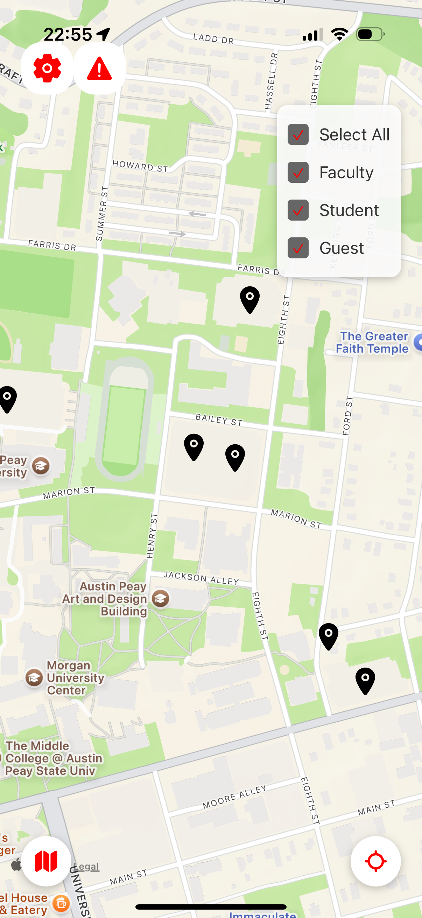
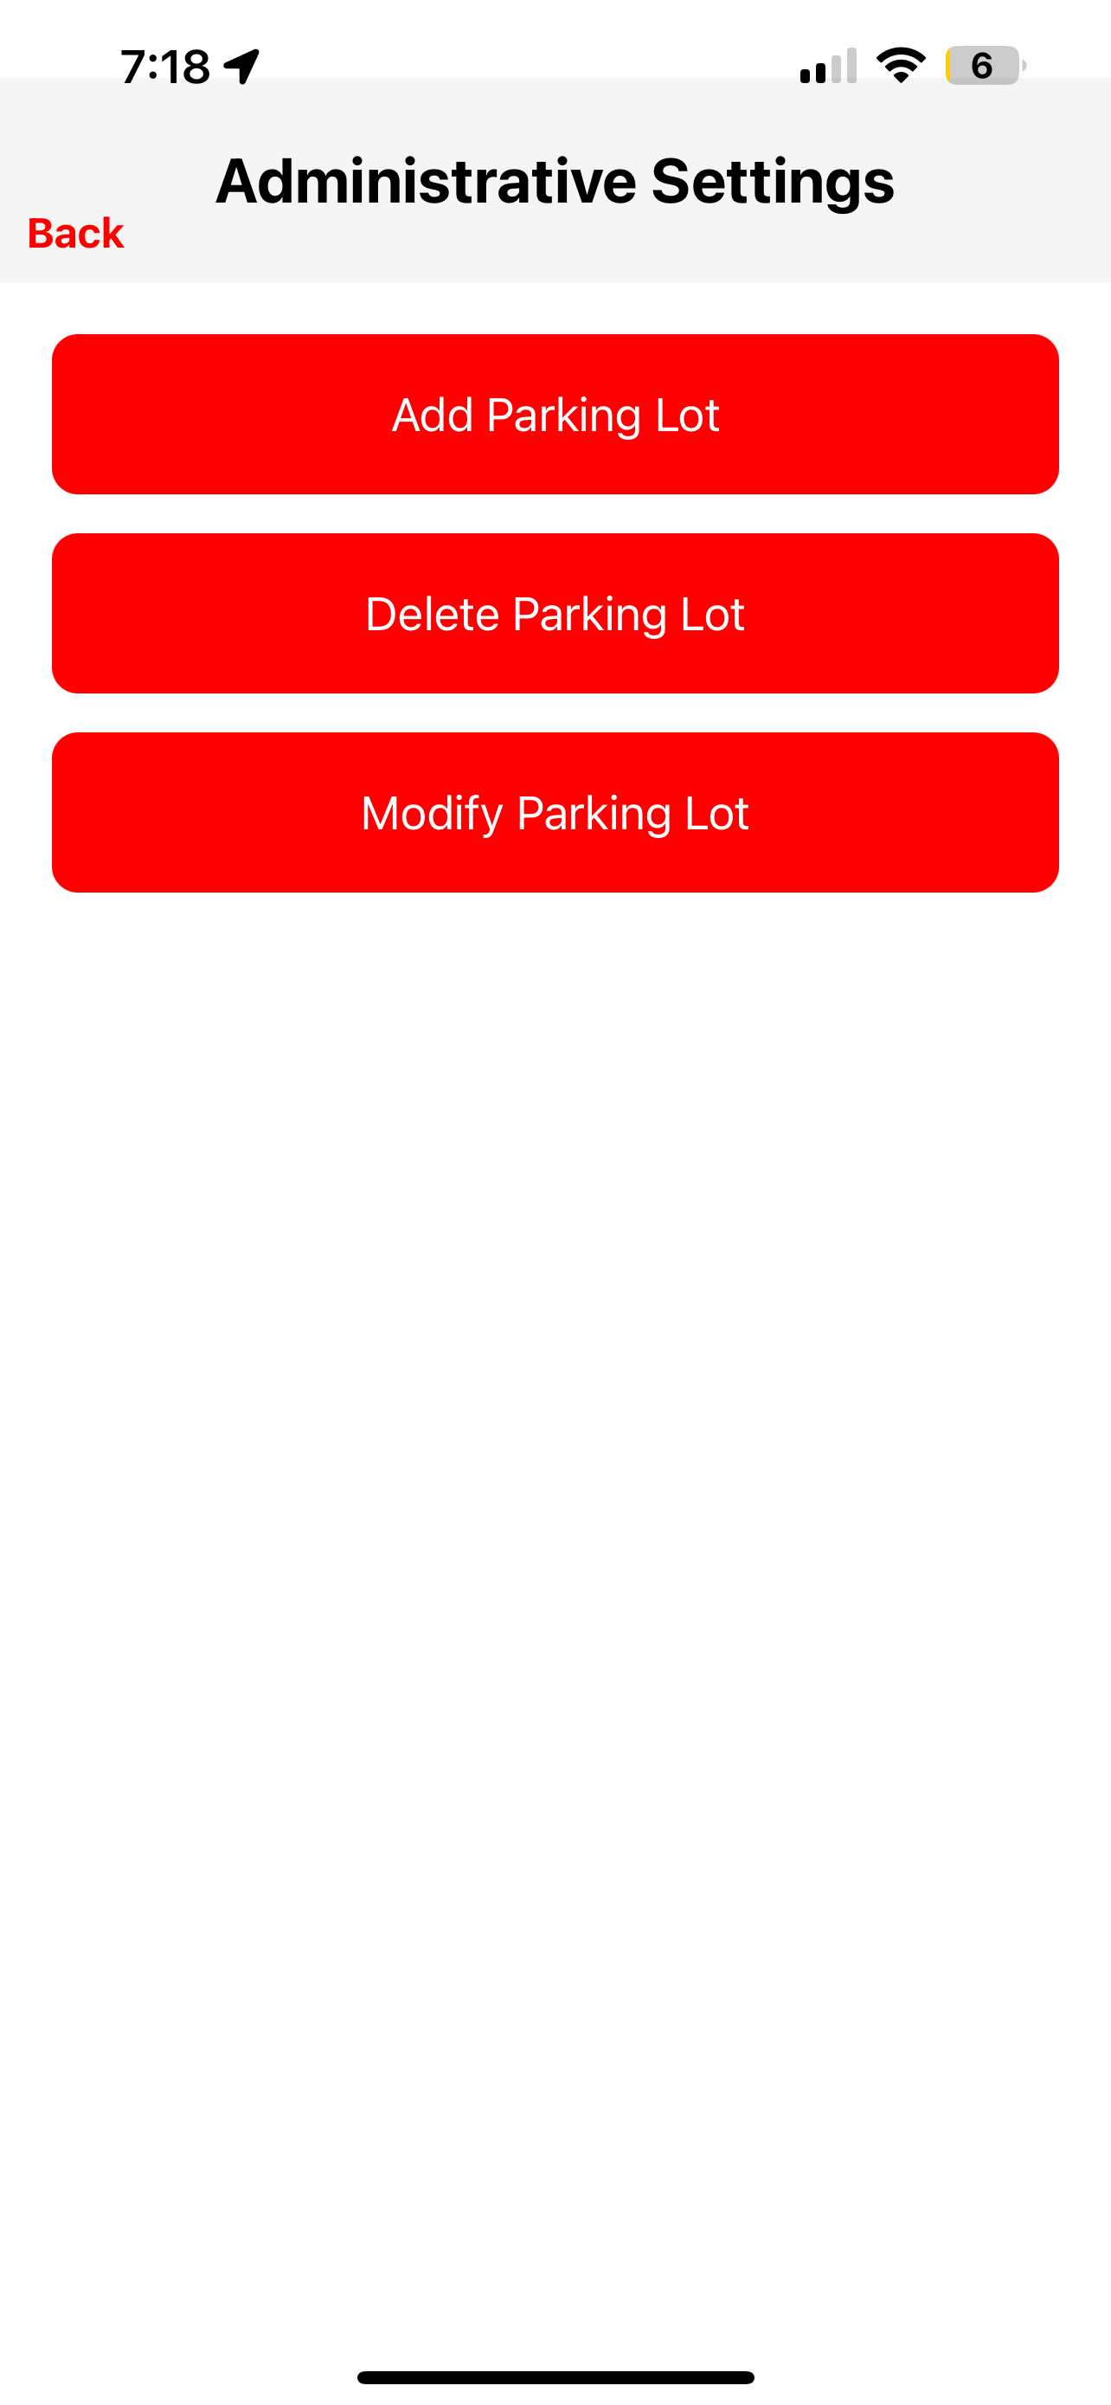
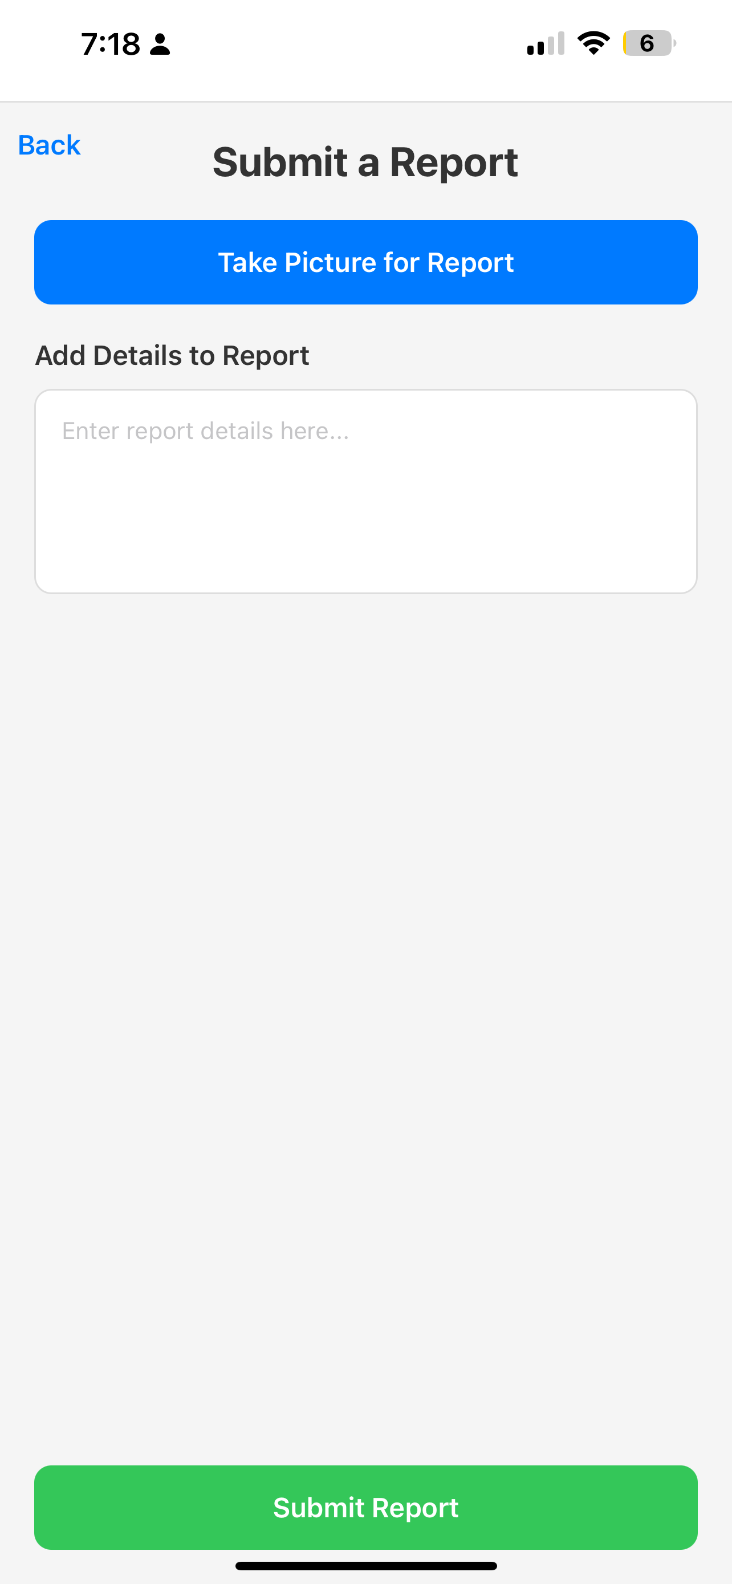
PeayPark
Jnaria Wheeler, Connor Dial, Mitchell Sollmann
Dept. Of Computer Science and Information Technology
Abstract
Backend Design
PeayPark is designed to simplify campus parking for students and staff by providing real-time updates through a user-friendly interface. Users can view current parking availability across campus, explore detailed information about individual lots, identify high- and low-capacity areas, and get directions to their chosen lot. The app also includes a reporting feature that allows users to flag improperly parked vehicles by submitting a photo along with a description of the issue. By combining real-time data with community-driven reporting, PeayPark aims to make parking more manageable and less stressful while reducing campus traffic and encouraging responsible parking behavior.
The backend is managed using SupaBase, which enables secure user authentication and real-time database functionality. Users are required to log in to submit or view reports, ensuring accountability and a sense of community-driven accuracy. SupaBase’s scalable infrastructure supports fast and reliable data synchronization between users and the backend. Parking lot occupancy is updated based on user interaction and location data, with plans to incorporate more automated tracking methods.
“There needs to be a good change in parking for the sake and sanity of Austin Peay students.” — The All State, 2023
Background
Parking at Austin Peay State University has long been a source of stress and frustration for students, faculty, and staff. Recent campus developments—like the removal of key faculty and overflow lots to make space for new buildings—have further reduced available parking and disrupted long-standing routines. As reported in The All State (2023), these changes have led to disproportionate commuter-to-space ratios, inconvenient lot locations for residential students, and increased competition for spots across campus. Inspired by these challenges and their own daily struggles with parking, our team developed PeayPark to give the APSU community a simple, efficient way to check parking availability, reduce wasted time, and make informed decisions before arriving on campus.
Technology
Figure: This is a block diagram that shows the simple system architecture of PeayPark. The front end consists of JavaScript-based components that run on a user's iOS or Android mobile device. These components send carefully-formatted requests to SupaBase to gather information about parking lots that can be displayed to users. SupaBase processes the requests and returns responses to the app, enabling real-time parking updates.
PeayPark is built using React Native, allowing for a responsive and consistent user experience whether they are on an Android or iOS. The backend is powered by SupaBase, which handles authentication, real-time data updates, and storage of user-generated reports. The app utilizes device location services to help determine proximity to lots and enhance report accuracy. Figma was used during the design process to prototype and refine the app’s UI/UX elements before implementation.
Live Demo
Frontend Design
The front end of PeayPark emphasizes simplicity and usability, with a clean, map-focused interface that displays all campus parking lots. Users can tap on a lot to view its status, including how many spots are likely occupied. The color-coded visual indicators and intuitive navigation reduce cognitive load and help users make quick decisions. React Native components and thoughtful layout design ensure consistency across devices. The UI was prototyped and tested internally using Figma to maintain visual clarity and intuitive interaction patterns.
Login Page
Map Page
Admin Settings
Reporting Page
References
React Natve. https://reactnative.dev/
SupaBase. https://supabase.com/
JavaScript. https://developer.mozilla.org/en-US/docs/Web/JavaScript
Figma. https://www.figma.com/
Acknowledgements
We would like to thank Dr. Karen Meisch for her support of students in the College of Science, Technology, Engineering & Mathematics, and Dr. Leong Lee for his support of students in the Department of Computer Science and Information Technology. We would also like to thank our amazing Professor, Dr. John Nicholson.

